Slide 1
Final Year Project: HawkEye

Slide 2
Project Team
Daniyal Wajid (48528)
Uzair Hassan (48525)
Supervisor: Ma’am Uzma Kiran (Senior Lecturer)

Slide 3
Table of Content
Problem
Solution
Progress Report Summary
Requirements
Design
Implementation
Next Steps
Prototype / Report

Slide 4
Introduction & Background
HawkEye is an AI-powered campus discipline monitoring system designed to detect violations such as dress code issues, weapons, and fights while identifying involved students through facial recognition.
Traditional manual monitoring is slow, inconsistent, and unable to cover large campus areas effectively.
With advancements in AI and Computer Vision, real-time automated surveillance has become possible.
HawkEye leverages these capabilities to provide a smarter, faster, and more reliable solution for maintaining campus safety and discipline.

Slide 5
Problem Statement
Maintaining discipline across large campuses is challenging due to limited staff, inconsistent manual monitoring, and delayed reporting of incidents.
Critical violations such as dress code breaches, fights, and potential weapon threats, often go unnoticed or are addressed too late.
There is no automated system to reliably identify students involved or to provide real-time evidence for quick decision-making.
This results in safety risks, inefficient enforcement, and lack of transparency in the discipline process.

Slide 6
Solution
HawkEye provides an AI-driven automated monitoring system that detects discipline violations in real time using facial recognition and behavior analysis.
It identifies students involved, captures evidence, and instantly notifies relevant authorities for quick action.
The system maintains a complete record of violations, automates fine generation, and allows students to report incidents through a secure mobile application. By replacing manual supervision with intelligent automation, HawkEye ensures faster response, improved safety, and transparent discipline management across the campus.

Slide 7
Features and Scope
HawkEye provides AI-powered detection of dress code violations, weapons, fights, and student identification through facial recognition.
It automatically logs incidents with evidence, generates fines, and sends real-time alerts to relevant authorities.
Students can report violations with a cooldown system and earn rewards for valid submissions.
The system includes dedicated dashboards for admins, discipline incharge, and students, offering complete visibility of violations, fines, and reports.
HawkEye aims to enhance campus safety, reduce manual monitoring, ensure transparent discipline management, and support future scalability with advanced analytics and predictive features.

Slide 8
Requirements
Elicitation Techniques / Tools
Interviews
Market / Literature Survey
Prototyping
Observation & Feedback Sessions
Specification / Documentation
Software Requirements Specification (SRS)
Project Scope Document
Feature List & Use Cases
Process Flows & Diagrams

Slide 9
Requirements
List of Different Users
Admin
Discipline Incharge / Teacher
Student
Use Cases
Manage students and violations
Detect violations automatically
Report violations manually
Review, approve, or reject incidents
Generate fines and rewards
View dashboards, alerts, and analytics

Slide 10
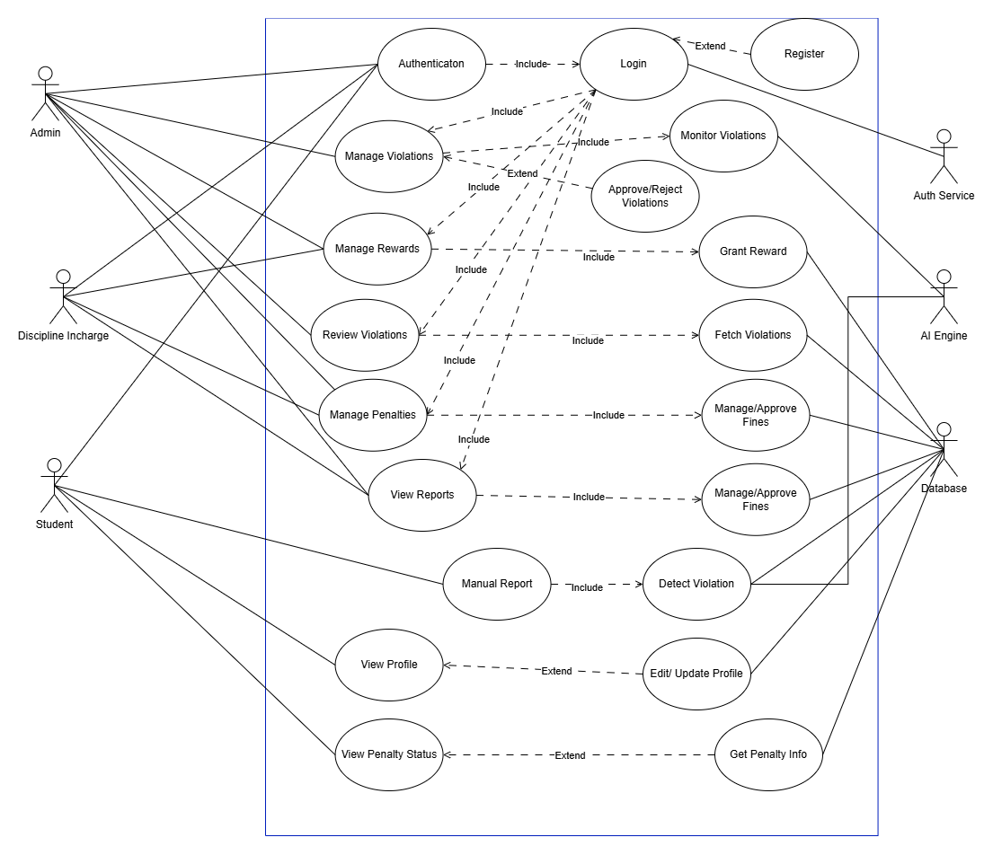
Use Case Diagram: System

Slide 11
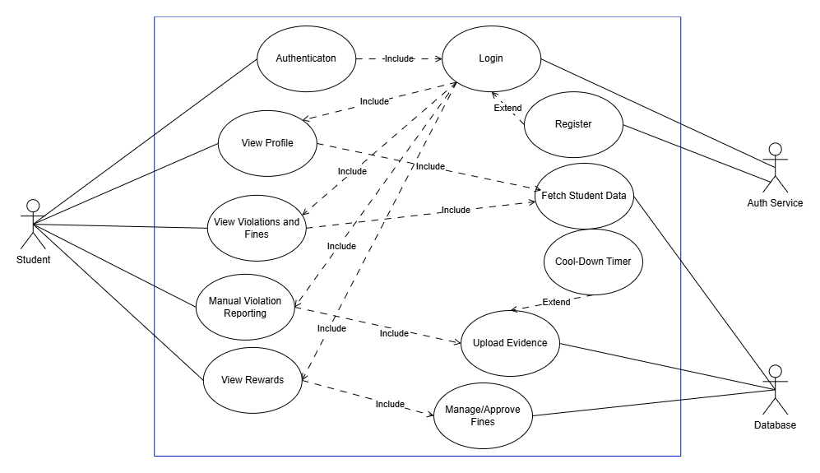
Use Case Diagram: Student

Slide 12
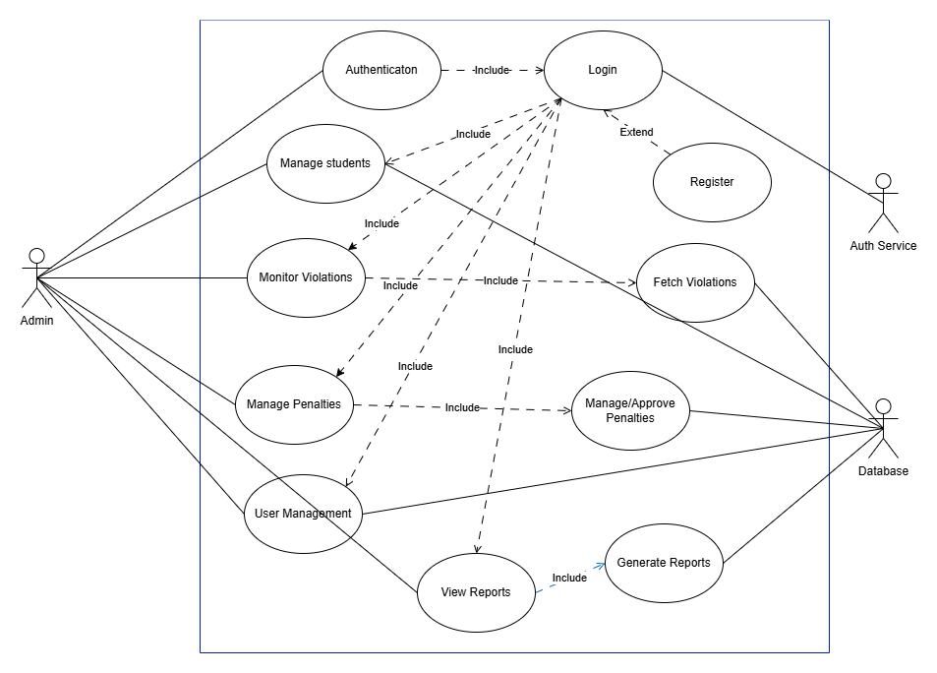
Use Case Diagram: Admin

Slide 13
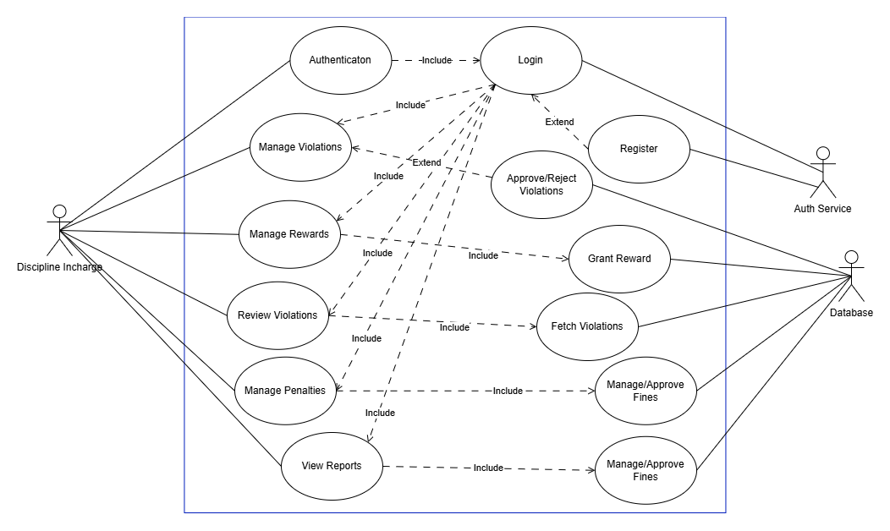
Use Case Diagram: Discipline Incharge

Slide 14
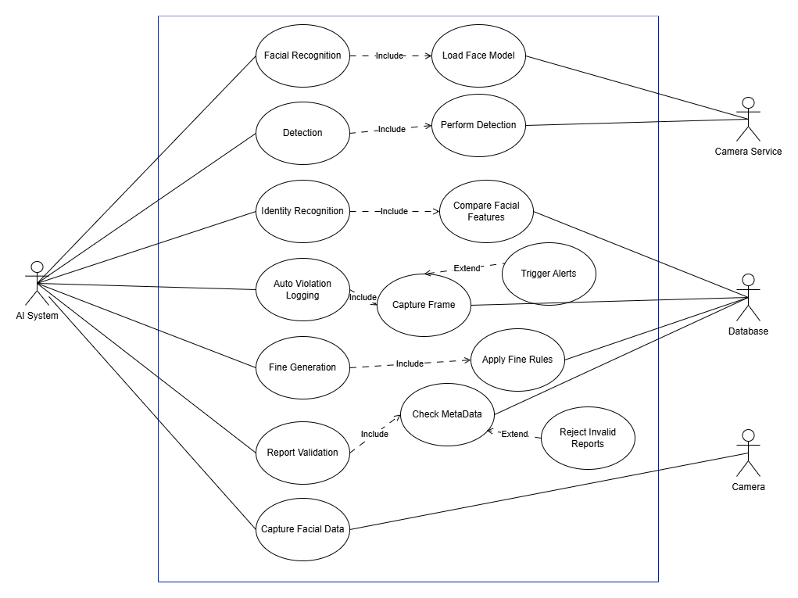
Use Case Diagram: AI System

Slide 15
Functional & Non Functional Requirements
Functional Requirements
User authentication and role-based access
Facial recognition and identity matching
Weapon, fight, and dress code detection
Fine and reward management
Non-Functional Requirements
High system accuracy and performance
Data security and encryption
User-friendly interfaces
Maintainability and modular architecture

Slide 16
System Design
Architecture Design
Entity Relationship Diagram
Class Diagram
Sequence / Collaboration Diagram
Activity Diagram

Slide 17
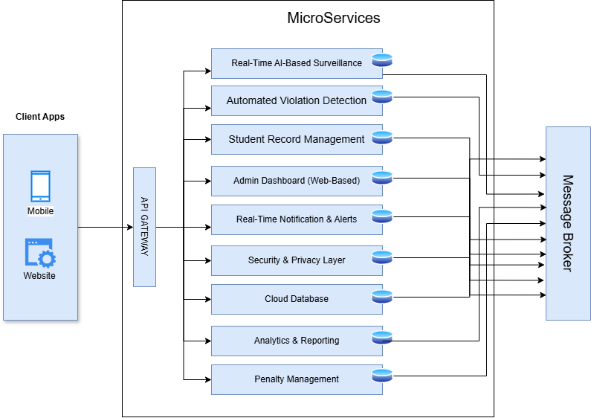
Architecture Design

Slide 18
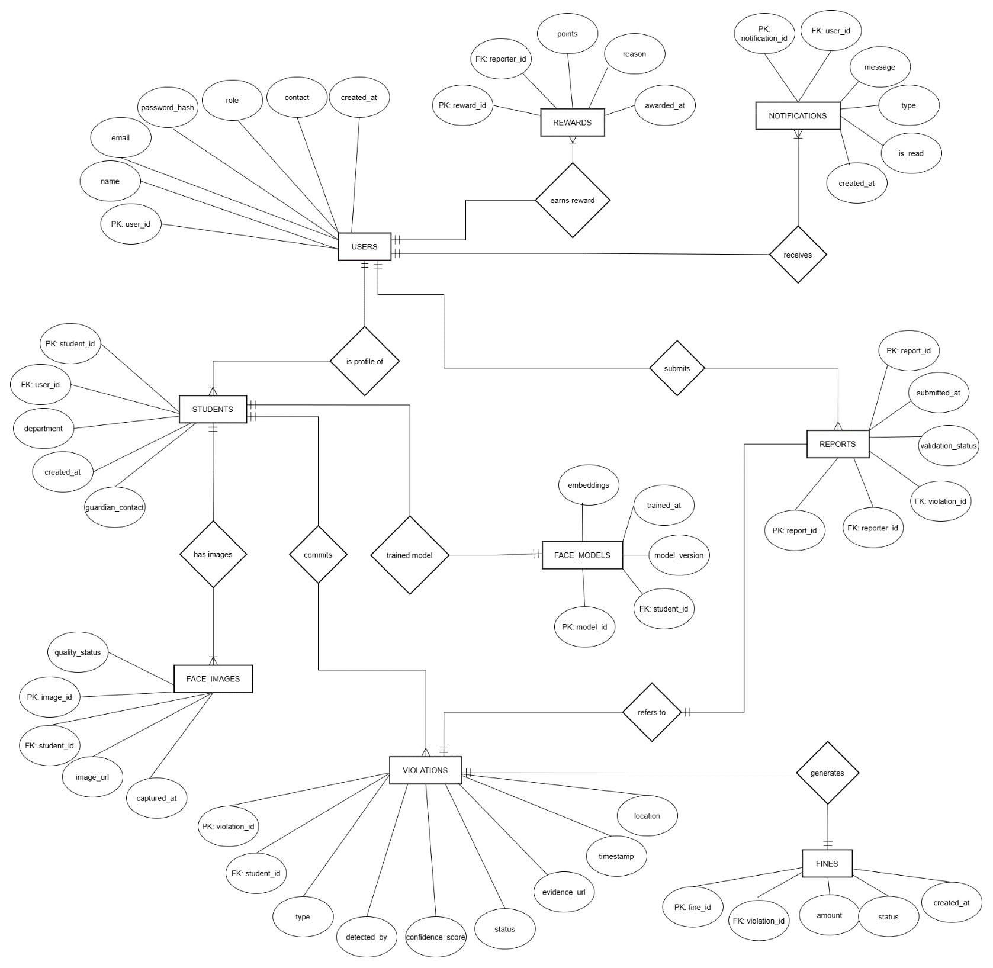
Entity Relationship Diagram

Slide 19
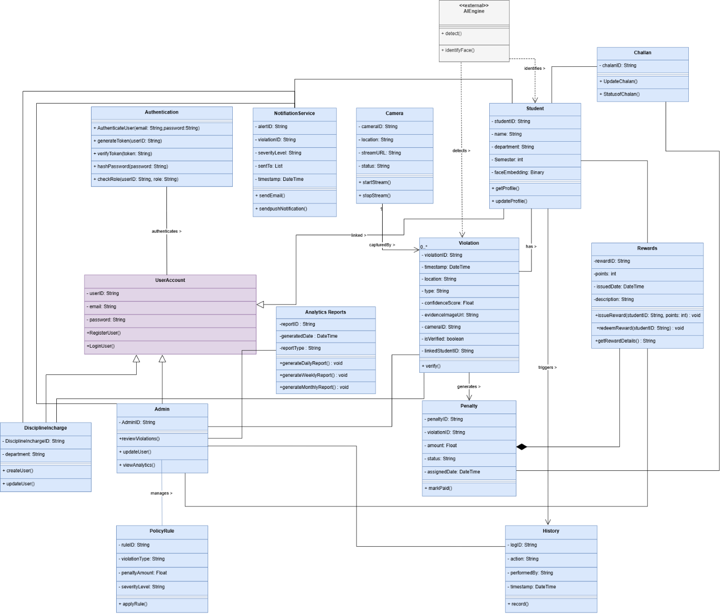
Class Diagram

Slide 20
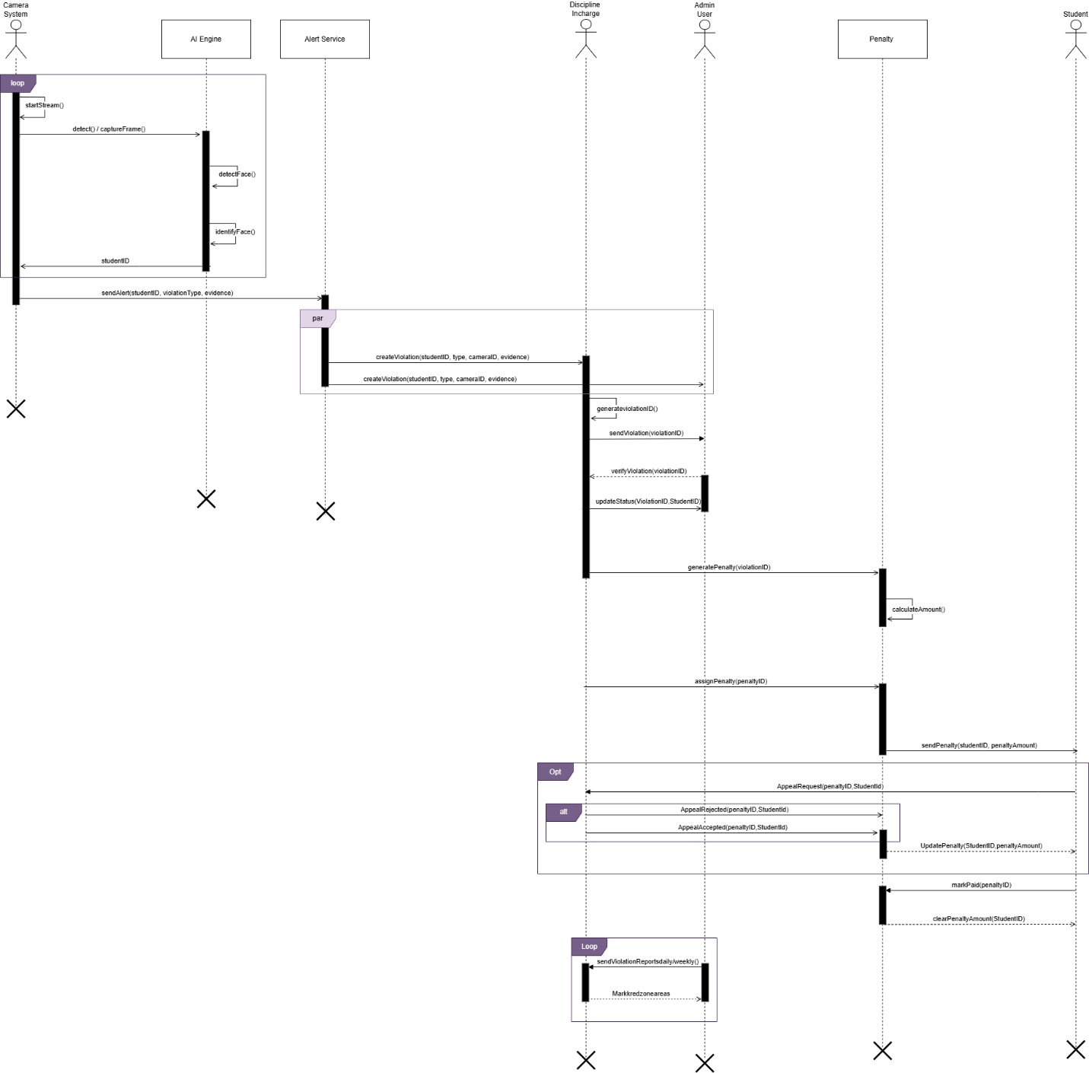
Sequence / Collaboration Diagram

Slide 21
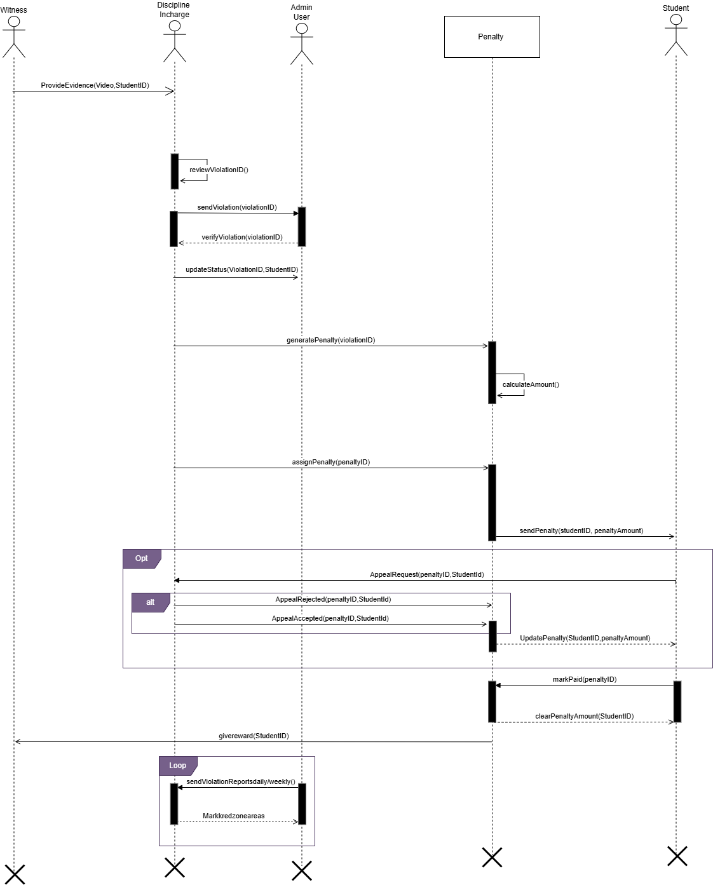
Sequence / Collaboration Diagram

Slide 22
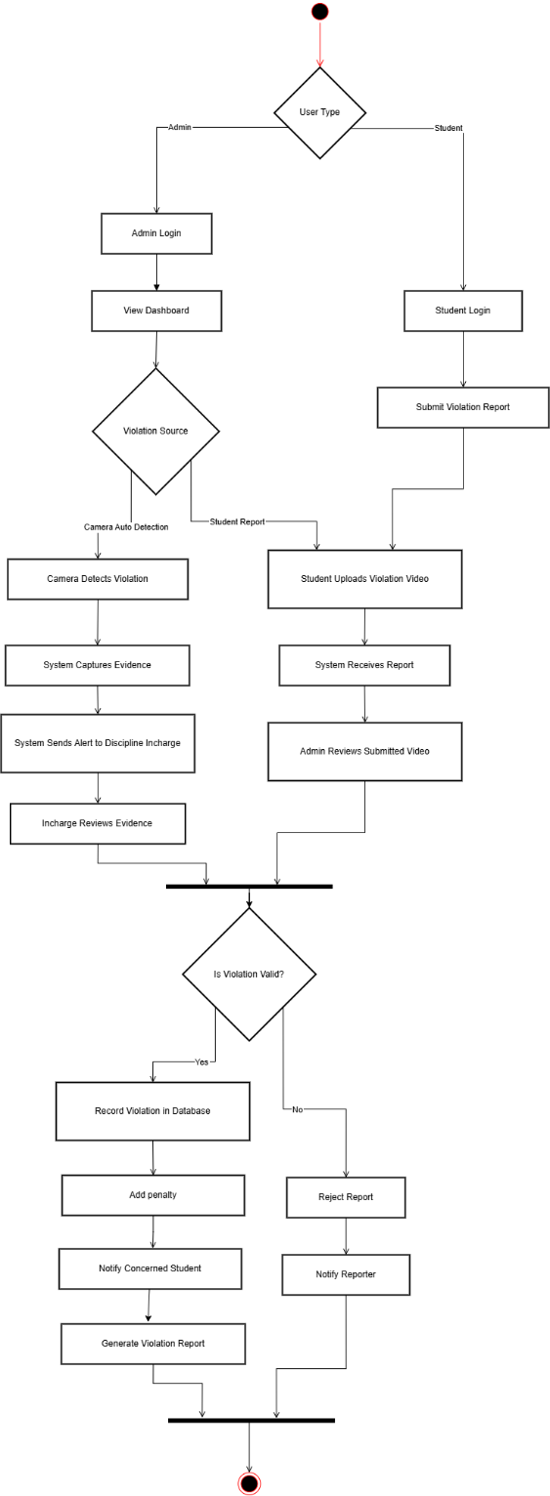
Activity Diagram

Slide 23
Implementation
HawkEye was developed using VS Code, Postman, GitHub, and Firebase. Key technologies include React, Flutter, Express.js, JWT, MongoDB Atlas, TensorFlow, OpenCV, and YOLOv8, supported by services such as live camera processing, model training, violation logging, and FCM notifications.
Development followed best practices including modular architecture, component-based UI, reusable AI modules, centralized error handling, environment variables, and a structured Git branching strategy to ensure maintainable and scalable code.

Slide 24
Challenges
HawkEye faced several challenges during development, including training accurate facial recognition models with limited student images, optimizing AI detection for varied lighting and camera angles, and ensuring reliable fight and weapon detection in real-time.
Integrating multiple modules, AI, backend, dashboards, and mobile app while maintaining smooth communication also required careful coordination.
Additional challenges included handling large image/video data efficiently, ensuring low-latency alerts, managing false positives in AI detection, and designing a secure, role-based system.
Deployment required addressing scalability, stable server performance, and continuous model updates as new students were added.

Slide 25
Prototype
Prototype Link: Discipline Monitoring System

Slide 26
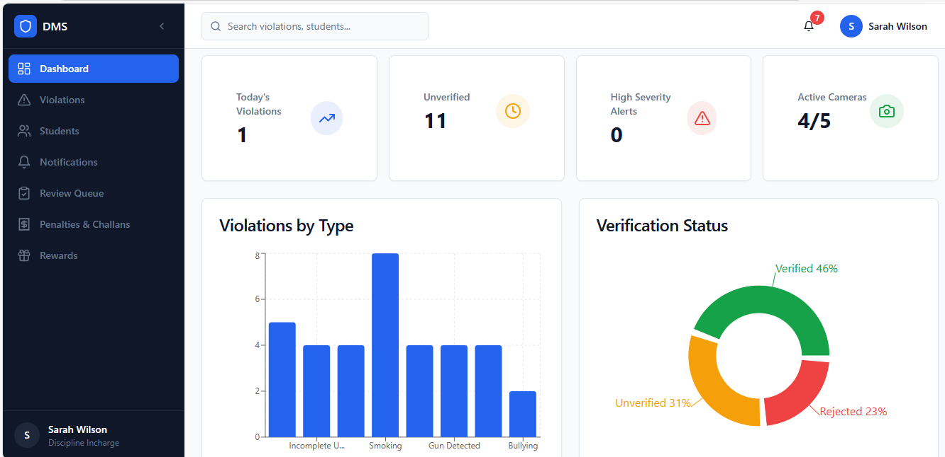
Screenshots

Slide 27
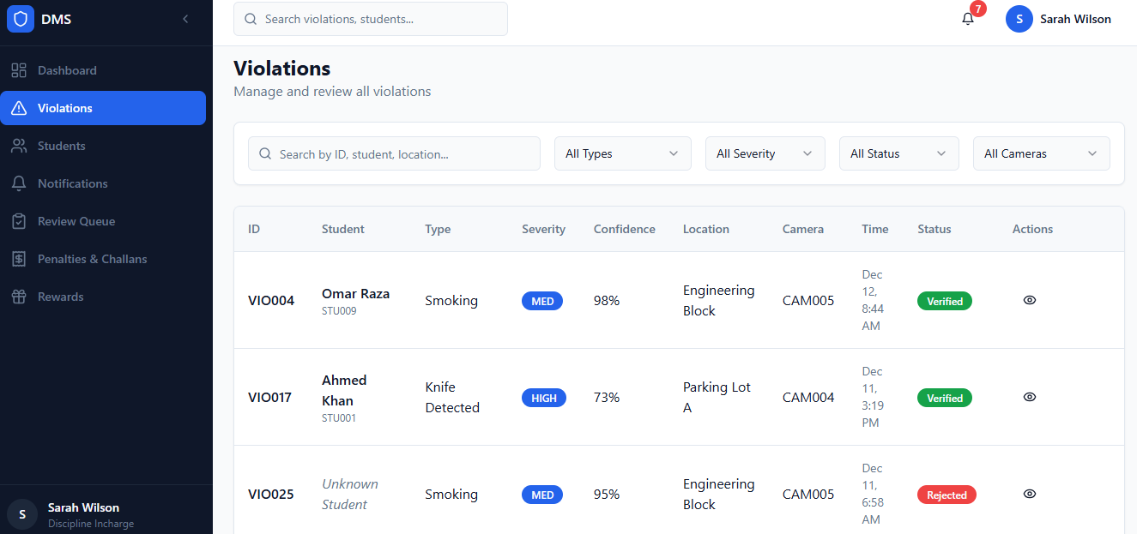
Screenshots

Slide 28
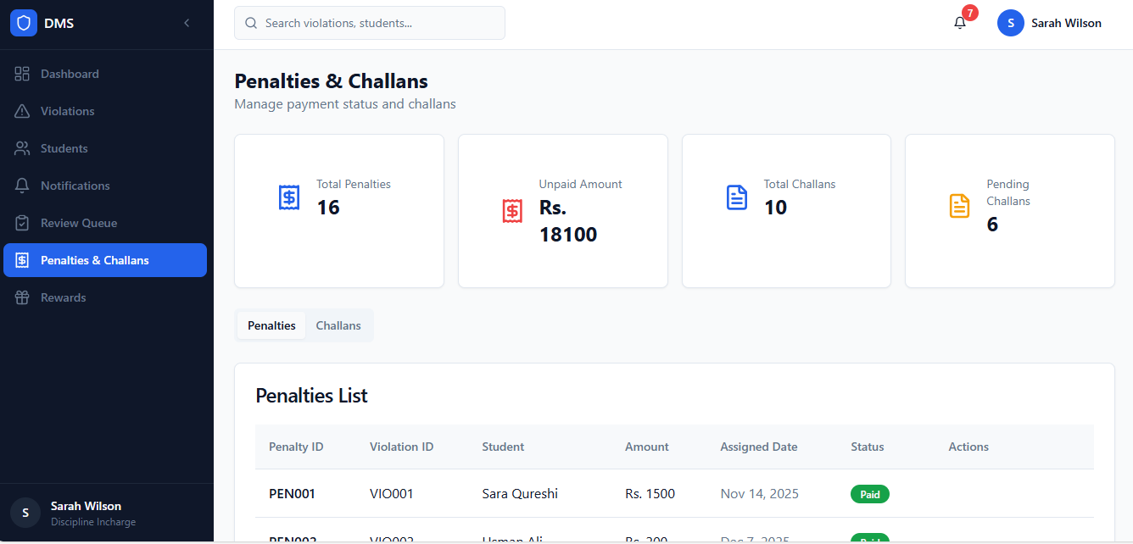
Screenshots

Slide 29
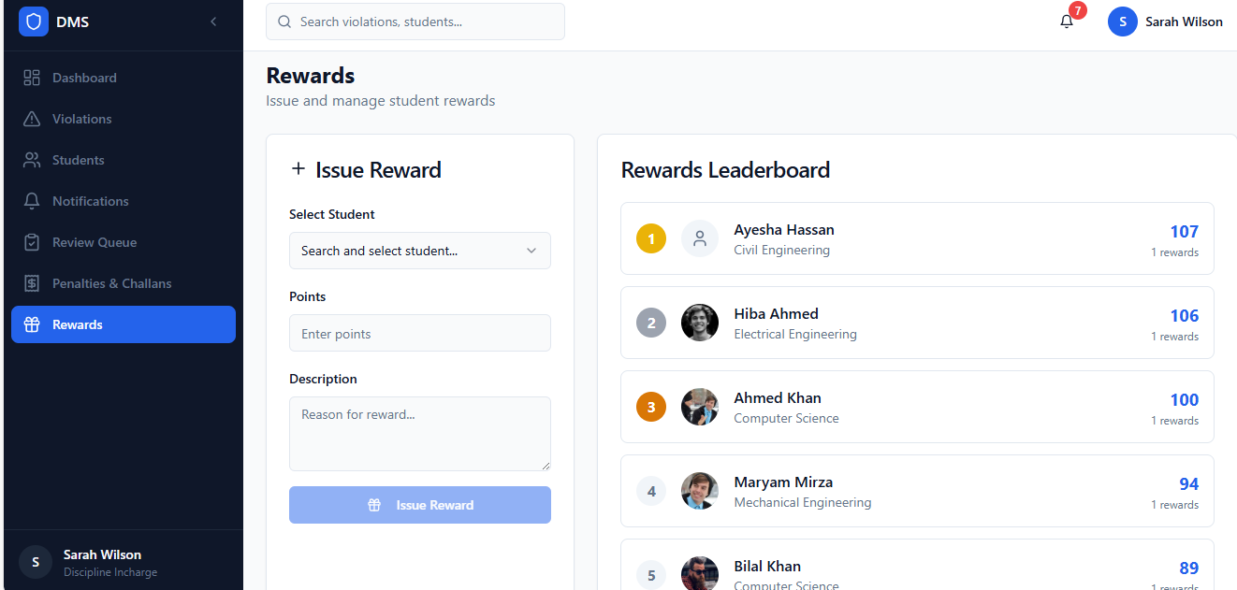
Screenshots

Slide 30
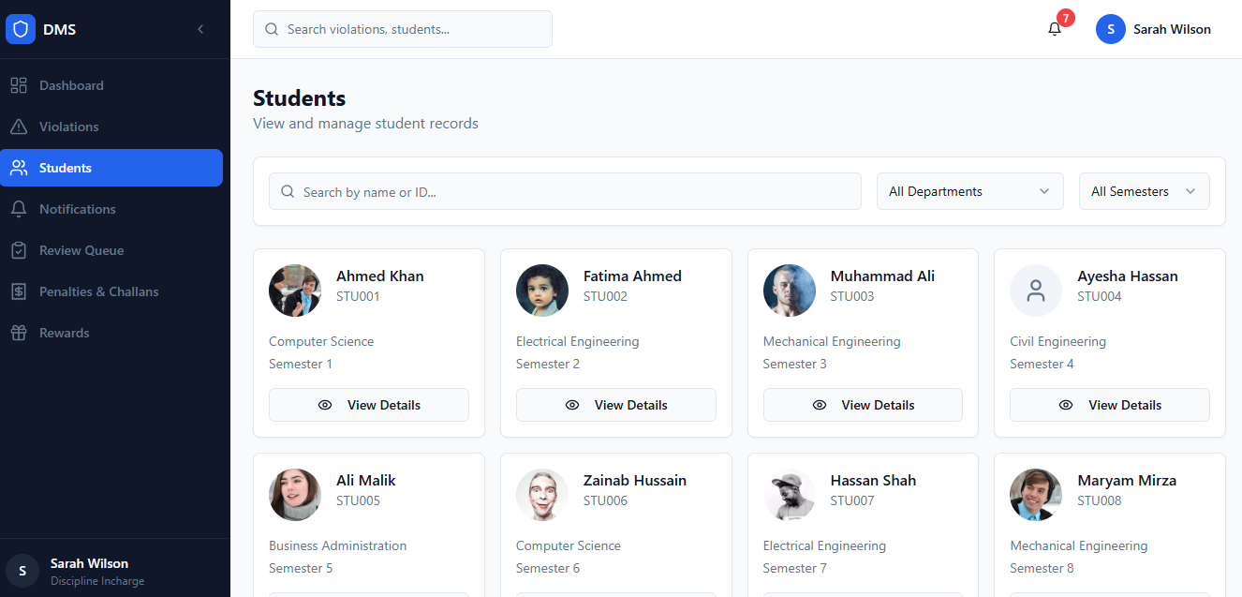
Screenshots

Slide 31
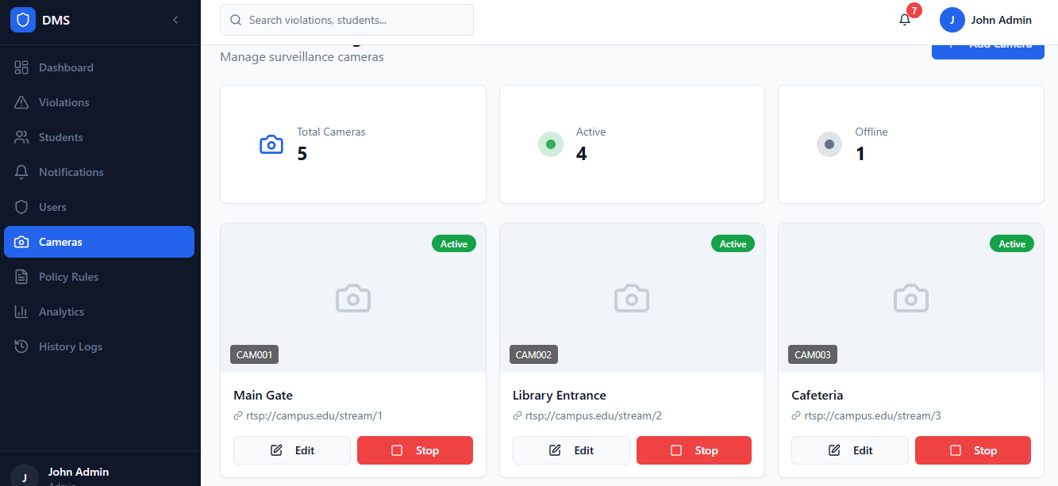
Screenshots

Slide 32
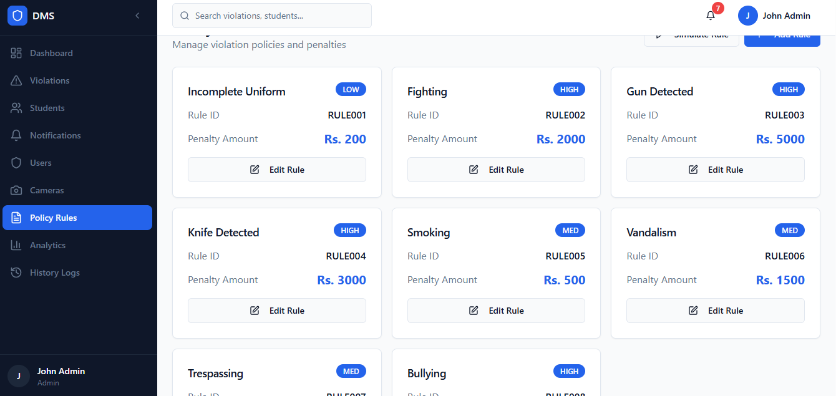
Screenshots

Slide 33
Report
Github Repository Link

